Slide 1
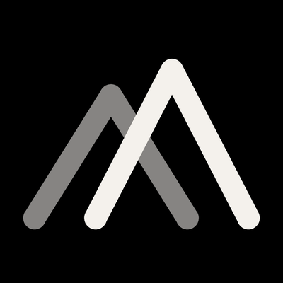
BRAND IDENTITY · v1.0 · 2026-05-23
SolarPlants
Closer to the ground.
Commercial brand of VERDEVOLT PROIECT S.R.L. · CUI 34742128 · J12/525/2016 · Cluj-Napoca, Romania

Slide 2
WHY · 01
Why this manual exists now.
Q3 2026 launch is the moment SolarPlants moves from research-stage to commercial-stage. Every external touchpoint from now on — site, deck, contract, business card, LinkedIn post — carries reputational weight with Tier-A and Tier-B investors who decide quickly on signal quality.
This manual exists to make those decisions easy: it codifies the visual and verbal system so that anyone — internal team, external designer, vendor, partner — can produce on-brand work the first time.
Five non-negotiables are locked: Ink & Copper palette · Inter + Fraunces typography · pure wordmark logo · 100 % real photography (Q4 2026) · senior/sober/expert/executive tone.
SolarPlants · Brand Identity · v1.0 · 2026-05-23
02 / 29

Slide 3
CONTEXT · 02
The strategic context.
TARGET MARKET
ICP
POSTURE
Turkey · Gulf · EU
€875k–€3M Y1 revenue
6 productized tracks Q3 launch
Tier A — Strategic funds + IPPs + Gulf SWFs
Tier B — Mid-market + family offices
Tier C — Exploratory inbound
Sage + Ruler archetype
Editorial-institutional
Senior · Sober · Expert · Executive
SolarPlants · Brand Identity · v1.0 · 2026-05-23
03 / 29

Slide 4
ESSENCE · 03
Romania's productized investor entry
platform for renewable energy.
Single local execution partner — from CfD-eligible RTB pipelines and BESS-co-located packages to financing introductions and operations support.
SolarPlants · Brand Identity · v1.0 · 2026-05-23
04 / 29

Slide 5
ARCHETYPE · 04
Sage + Ruler.
THE SAGE
THE RULER
Authority. Expertise. Depth.
Knowledge accumulated over 25 years.
We explain Romania to global capital.
Control. Order. Leadership.
Structured engagements, transparent pricing,
clear deliverables.
NOT Hero. NOT Outlaw. NOT Magician.
SolarPlants · Brand Identity · v1.0 · 2026-05-23
05 / 29

Slide 6
POSITIONING · 05
Positioning, in one paragraph.
For international investors who want to invest in renewable energy in Romania, SolarPlants is the productized investor entry platform that delivers structured access — from CfD-eligible RTB pipelines and BESS-co-located packages through local execution support — through transparent, fixed-price advisory tiers.
Unlike consultants who quote custom-only, EPC-led shops with bias, or boutiques without Turkish-specific cultural fluency, we offer the only Romanian advisory platform combining productized pricing, Turkey-RO bridge, BESS-included default, and local execution under one roof.
SolarPlants · Brand Identity · v1.0 · 2026-05-23
06 / 29

Slide 7
TAGLINES · 06
Three taglines tested.
01
Clarity in Romanian Renewables.
Primary — translates cleanly to RO / TR / AR.
02
Your Local Platform for Renewable Energy Investment in Romania.
Baseline — long-form copy use.
03
From Investor Entry to RTB to EPC to Operations.
Narrative — internal + funnel use.
SolarPlants · Brand Identity · v1.0 · 2026-05-23
07 / 29

Slide 8
PERSONALITY · 07
If SolarPlants were a person…
ATTRIBUTE
YES
NO
Age
45–55
25
Dress
Sober suit, mechanical watch
Hoodie, sneakers, smartwatch
Car
Executive sedan (Audi A6, BMW 5)
Showy SUV, Tesla with spoiler
Meeting
5-star hotel, quiet restaurant, 7 pm
Coffee shop, networking event
Reading
The Prize (Yergin), Smil, McKinsey
Self-help, '10 hacks to…'
Holiday
Bosphorus walk + business meeting
Entrepreneur camp
SolarPlants · Brand Identity · v1.0 · 2026-05-23
08 / 29

Slide 9
TONE · 08
Senior. Sober.
Expert. Executive.
Never marketingese.
SolarPlants · Brand Identity · v1.0 · 2026-05-23
09 / 29

Slide 10
AUDIENCE · 09
Audience tiers.
Tier A
Tier B
Tier C
Strategic
Serious mid-market
Exploratory
Infrastructure funds (Actis, EQT, Mubadala)
IPPs (Rezolv, Statkraft)
TR groups (Koç, Kalyon, Sabancı)
Gulf SWFs (Masdar, ACWA)
Family offices TR (Yeşilyurt)
Entrepreneurial groups (Limak, Sanko)
Gulf private offices
Investors in research mode
ESG-curious industrials
Individual private wealth >$10M
€50M–€500M+
€10M–€80M
€5M–€20M intent
SolarPlants · Brand Identity · v1.0 · 2026-05-23
10 / 29

Slide 11
VOICE · 10
Three cultural registers.
TURKISH
GULF
EU INSTITUTIONAL
[FirstName] Bey / Hanım — never first name alone.
Open with relationship, then pitch.
Hospitality language welcome.
'We would be honored to host you in Cluj.'
Full titles (Mr., Dr.). First names only when invited.
Formal openings + closings.
Avoid casual 'inshallah' in writing.
Santiago Principles register for SWFs.
Sober · evidence-based · citation-heavy.
Reference CfD, ETS, RED III framework.
Avoid superlatives.
Numbers > adjectives.
SolarPlants · Brand Identity · v1.0 · 2026-05-23
11 / 29

Slide 12
COLOR · 11
Ink & Copper.
Ink-marine
Slate
Copper
#0E1A24
#2A3942
#B87333
Copper hover
Warm bone
Cool grey
#C9893F
#F4F1EC
#7A8A92
SolarPlants · Brand Identity · v1.0 · 2026-05-23
12 / 29

Slide 13
COLOR · 12
80 / 15 / 5.
80 % Bone background
15 % Ink + Slate
5 % Copper
One copper element per view — never more.
Copper highlights the CTA, the key data line, the recommended-tier mark, or a single divider. Pick one. The rest stays slate or cool grey.
SolarPlants · Brand Identity · v1.0 · 2026-05-23
13 / 29

Slide 14
TYPOGRAPHY · 13
Fraunces + Inter.
FRAUNCES — DISPLAY + EDITORIAL
INTER — BODY + UI + DATA
Editorial.
Premium.
Workhorse.
Geometric.
Google Fonts · FREE · variable opsz 9–144
Google Fonts · FREE · weights 300–800
SolarPlants · Brand Identity · v1.0 · 2026-05-23
14 / 29

Slide 15
TYPOGRAPHY · 14
Type scales.
H1 Hero — Fraunces 300, opsz 144, –2.5 %
Romanian renewables, structured.
H2 Section — Fraunces 400, opsz 96, –2 %
Clarity in Romanian Renewables.
H3 Sub — Inter 600, 28 px
Productized investor entry tiers.
Body — Inter 400, 17 px, line-height 1.6
We help international investors enter and execute in the Romanian PV, BESS and hybrid renewables market.
Caption — Inter 500, 13 px, +1 %
Source: SolarPlants 2026 market memo.
SolarPlants · Brand Identity · v1.0 · 2026-05-23
15 / 29

Slide 16
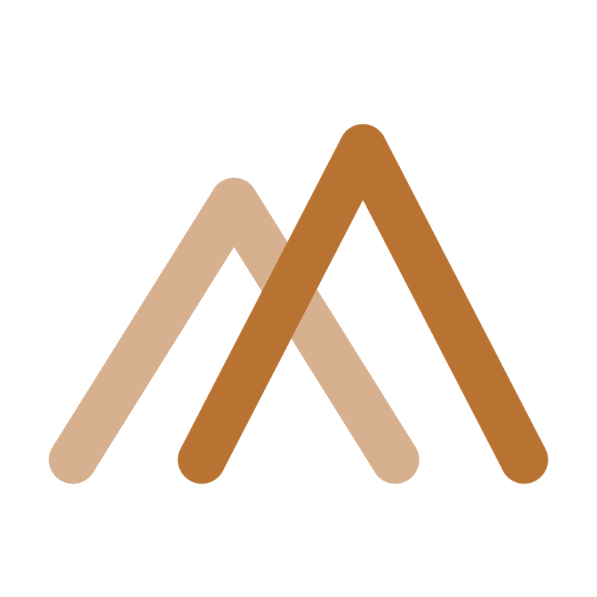
LOGO · 15
Pure wordmark + Twin Peaks Mark.
SolarPlants
Fraunces 400 opsz 144 wordmark · two open copper chevrons · baseline-aligned · punctuation-spaced
No symbol. No icon. No horizon. No mascot. No gradient. Just two peaks.
SolarPlants · Brand Identity · v1.0 · 2026-05-23
16 / 29

Slide 17
THE MARK · STORY
Two peaks, raised toward the same light.
"Two peaks, raised toward the same light — capital meets execution, generation meets storage, the mandate meets the operating asset. One signature carrying both."
TWO PEAKS, ONE ASCENT
OPEN AT THE BASE
THE COLOR OF LIGHT AT WORK
A single triangle just points. Two overlapping peaks describe a horizon — two slopes rising toward the same summit. Vision and execution, generation and storage, the hand that signs and the hand that builds.
The chevrons meet at the apex and stay open at the base — like a widening horizon. Everything has a way in: capital, equipment, partners, communities. The Mark stays open because the work is open.
Copper carries the current from panel to grid — the metal that makes solar real. Green is what the industry says; copper is what the industry runs on. The color that catches the dawn.
SolarPlants · Brand Identity · v1.0 · 2026-05-23
17 / 29

Slide 18
LOGO · 16
Four variants + favicon.
SolarPlants
SolarPlants
PRIMARY
Default 80 %
MONOCHROME
Print + fax + legal
SolarPlants
SolarPlants
REVERSE
Dark mode + video
SIMPLIFIED
≤48 px applications
SolarPlants · Brand Identity · v1.0 · 2026-05-23
17 / 29

Slide 19
LOGO · 17
Logo — never do these.
×
Don't color the wordmark Copper — Copper is for CTA, not logo.
×
Don't add symbols, icons, horizons, leaves, sunbursts, panels, gradients.
×
Don't bold beyond Fraunces 500 (reverse only). Default is 400.
×
Don't substitute Fraunces with Times / Georgia / Cambria.
×
Don't ALL-CAPS the marketing logo.
×
Don't append 'Energy' / 'Group' / 'Romania' inline.
×
Don't place on photographic backgrounds without a solid plate.
×
Don't squeeze, stretch, rotate, animate the wordmark.
SolarPlants · Brand Identity · v1.0 · 2026-05-23
18 / 29

Slide 20
ENTITY · 18
SolarPlants + VerdeVolt.
COMMERCIAL BRAND
LEGAL ENTITY
SolarPlants
VERDEVOLT PROIECT SRL
Public-facing identity.
Marketing · content · site · LinkedIn · publication · conferences · op-eds.
Never appears on a contract.
Romanian SRL · CUI 34742128 · J12/525/2016
Founded 2016 · 8 years vehicle.
ANRE D1 attestation 21749/2024.
Always on LOI / MSA / NDA / contract / KYC.
SolarPlants · Brand Identity · v1.0 · 2026-05-23
19 / 29

Slide 21
ENTITY · 19
VerdeVolt — redesigned.
VERDEVOLT
PROIECT · S.R.L. · CUI 34742128
Inter 700 ALL CAPS, +6 % tracking · Copper subtitle.
D37 LOCKED — superseded the original anthracite + lime-green badge.
Brand-vs-entity distinction now lives in typography + naming, not divergent palette.
SolarPlants · Brand Identity · v1.0 · 2026-05-23
20 / 29

Slide 22
LOCKUP · 20
The coexistence lockup.
COMMERCIAL BRAND
LEGAL ENTITY
SolarPlants
VERDEVOLT
PROIECT · S.R.L. · CUI 34742128
HORIZONTAL — for footers, business card backs, invoice headers, signature blocks.
VERTICAL — for KYC packs, cover pages, deck 'Legal Entity' slide, letterhead.
SolarPlants · Brand Identity · v1.0 · 2026-05-23
21 / 29

Slide 23
LOGO SYSTEM · 21
When to use what.
Homepage, LinkedIn, blog, publication
SolarPlants alone
Pitch deck cover (commercial side)
SolarPlants alone
Pitch deck 'Technical Credentials / Legal Entity'
VerdeVolt or Lockup vertical
Site footer
Lockup horizontal + disclosure
Business card front / back
SolarPlants / Lockup
Invoice / receipt
Lockup horizontal
LOI / MSA / NDA / contract
VerdeVolt alone
KYC pack cover
VerdeVolt or Lockup vertical
Email signature line 1 / footer
SolarPlants / Disclosure line
SolarPlants · Brand Identity · v1.0 · 2026-05-23
22 / 29

Slide 24
APPLICATIONS · 22
Web, decks, documents.
WEB · solarplants.com
Shopify Horizon, Revolut paradigm:
full-bleed Ink hero, large whitespace, bold typography, restrained animation.
CTA = Copper fill, Bone text, 4 px radius.
DECKS · 16:9
Cover: Ink full-bleed, reverse logo, Fraunces H1 centered, Copper eyebrow.
Content: Bone bg, Ink + Slate text, max 6 lines/slide, one Copper accent.
Data: Inter tabular, Copper key line, Slate grid.
DOCUMENTS · DOCX + PDF
Letterhead: Lockup horizontal + disclosure footer.
Body: Inter 11 pt, line-height 1.5.
Headings: Fraunces 18 pt + Copper eyebrow.
SolarPlants · Brand Identity · v1.0 · 2026-05-23
23 / 29

Slide 25
APPLICATIONS · 23
Business card + signature.
EMAIL SIGNATURE
Radu Eremciuc
Managing Director · SolarPlants
SolarPlants
W +40 264 ... E radu@solarplants.ro
solarplants.com · in/radueremciuc
—
SolarPlants is the commercial brand of
VERDEVOLT PROIECT SRL · CUI 34742128
FRONT — Bone + primary logo centered
J12/525/2016 · Cluj-Napoca, Romania
SolarPlants · Brand Identity · v1.0 · 2026-05-23
24 / 29

Slide 26
PHOTOGRAPHY · 24
100 % real — Q4 2026.
Photography production deferred to Q4 2026 (decision A2). Until then: placeholder plates and diagrams.
WHEN WE SHOOT
· Radu portrait — half-day · €800–1,200
· Team headshots — half-day · €800–1,200
· Project portfolio + drone — full-day · €1,500–2,500
· Process / working photography — continuous ad-hoc
Total Q4 envelope: €3.5–5.5k. Style: natural side-lit, asymmetric, one LUT across library, never stock.
SolarPlants · Brand Identity · v1.0 · 2026-05-23
25 / 29

Slide 27
ICONOGRAPHY · 25
Phosphor · 1.5 px stroke.
·
Phosphor Icons preferred. Lucide acceptable secondary. Never mix.
·
Stroke 1.5 px at 24 px canvas. Corner radius 2 px on containers.
·
Ink #0E1A24 default. Copper only when the icon matches a copper-highlighted element.
·
No religious symbols. No anthropomorphic mascots. No hand-gesture pictograms.
SolarPlants · Brand Identity · v1.0 · 2026-05-23
26 / 29

Slide 28
COMPLIANCE · 26
What we always say.
What we never say.
MANDATORY DISCLOSURE
SolarPlants is the commercial brand of VERDEVOLT PROIECT S.R.L., CUI 34742128, J12/525/2016. We hold ANRE attestation D1 21749/2024 for design of electrical lines. We do not guarantee transaction closing, financing approval, grant award, permit issuance, or project success.
BANNED PHRASING
× Guaranteed yield · Expected ROI X % · Your investment will return Y
× We have €X bn pipeline (without cited source)
× We are ANRE-certified EPC contractor (D1 is design, not full EPC)
× We recommend investing in… (SolarPlants is not ASF-licensed)
SolarPlants · Brand Identity · v1.0 · 2026-05-23
27 / 29
× Best · Leading · World-class · Top-rated (unless verifiable)

Slide 29
CLOSING
This is who we are.
One brand. One voice. One palette. One typography system.
Anything that doesn't match this manual doesn't ship.
SolarPlants · Brand Identity · v1.0 · 2026-05-23 · Companion: Brand-Manual-Ink-Copper-v1.docx

